Slide 1

CampusElect By Cyber Corsair

Slide 2
Problem Statement
College elections are often manual, time-consuming, and prone to errors.
Need for a secure, transparent, and efficient online voting system.
Challenges:
Ensuring voter eligibility.
Preventing duplicate voting.
Real-time vote tracking.
Dynamic election management.

Slide 3
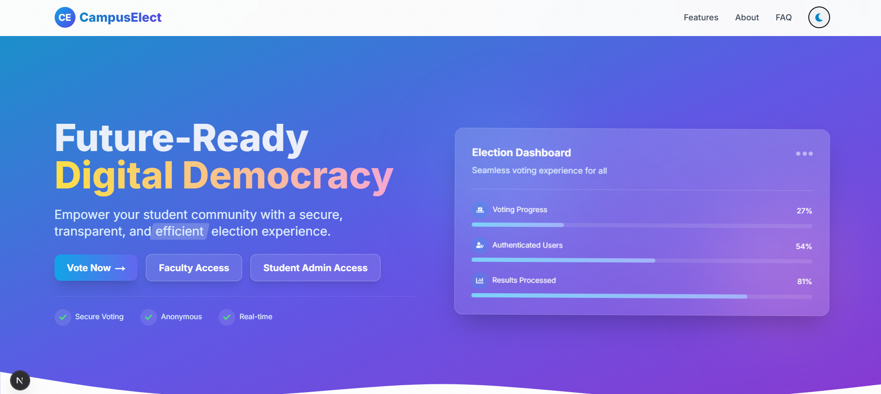
Solution Overview
CampusElect: A web application for conducting college elections.
Key Features:
Admin portal for election management.
Secure voter authentication using passkeys and OTP.
Real-time vote counting and tracking.
Dynamic ballot generation based on eligibility.
Scalable and user-friendly design.

Slide 4
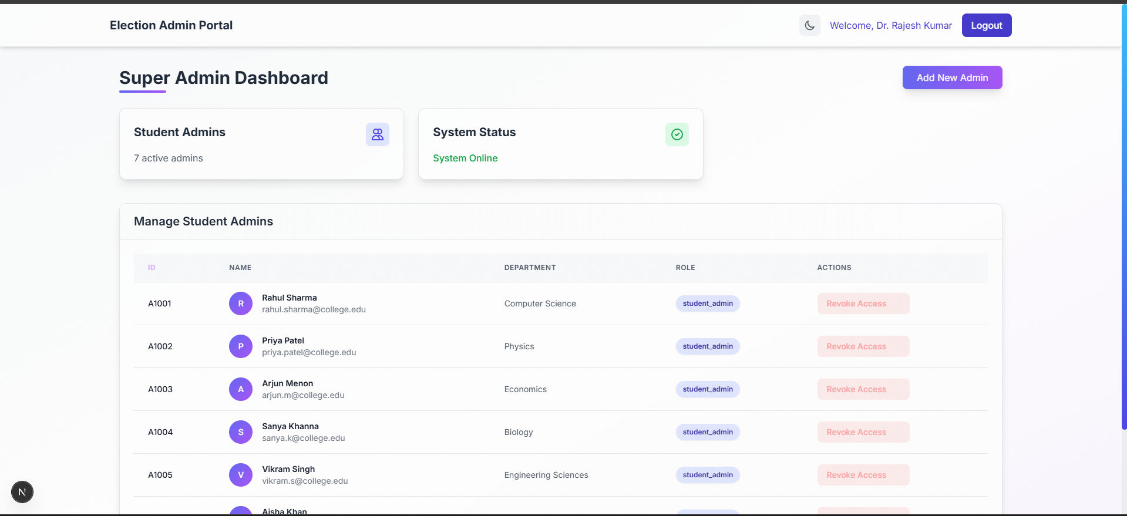
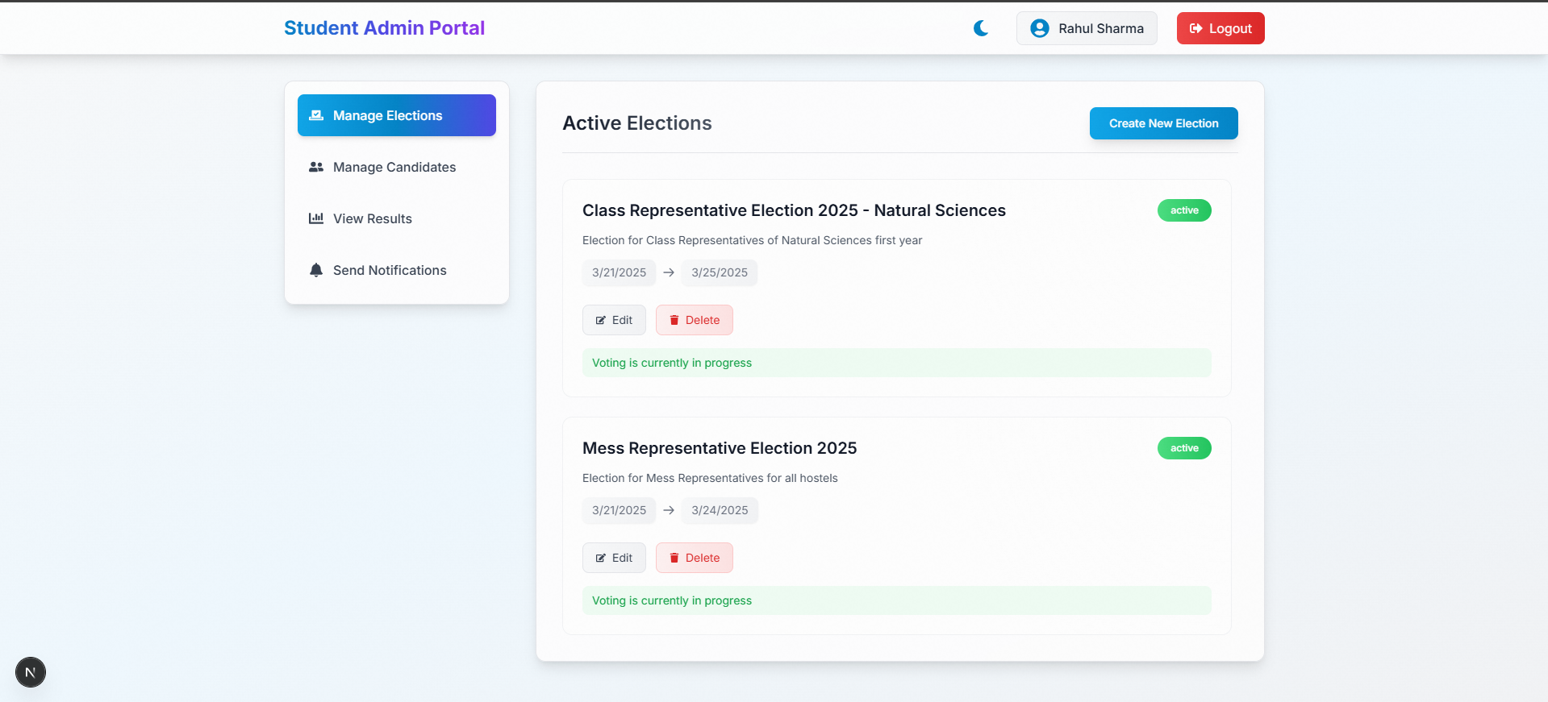
Admin Portal Feature
Faculty Super Admin:
Assign/revoke Student Admin roles.
Override control for emergencies.
Student Admin:
Add candidates for election positions.
Upload voter data via CSV or manual input.
Send automated emails with unique voting passkeys.
Real-time tracking of voting progress.
Security Measures:
Audit logs for admin actions.
Secure authentication system.

Slide 5
Voter Portal Feature
Secure Authentication:
Passkey-based login.
OTP verification for voting page access.
Dynamic Ballot Generation:
Voters only see positions they are eligible for.
Anonymous Voting:
Votes are stored as counts, not linked to individuals.
Confirmation Message:
Success notification after vote submission.

Slide 6
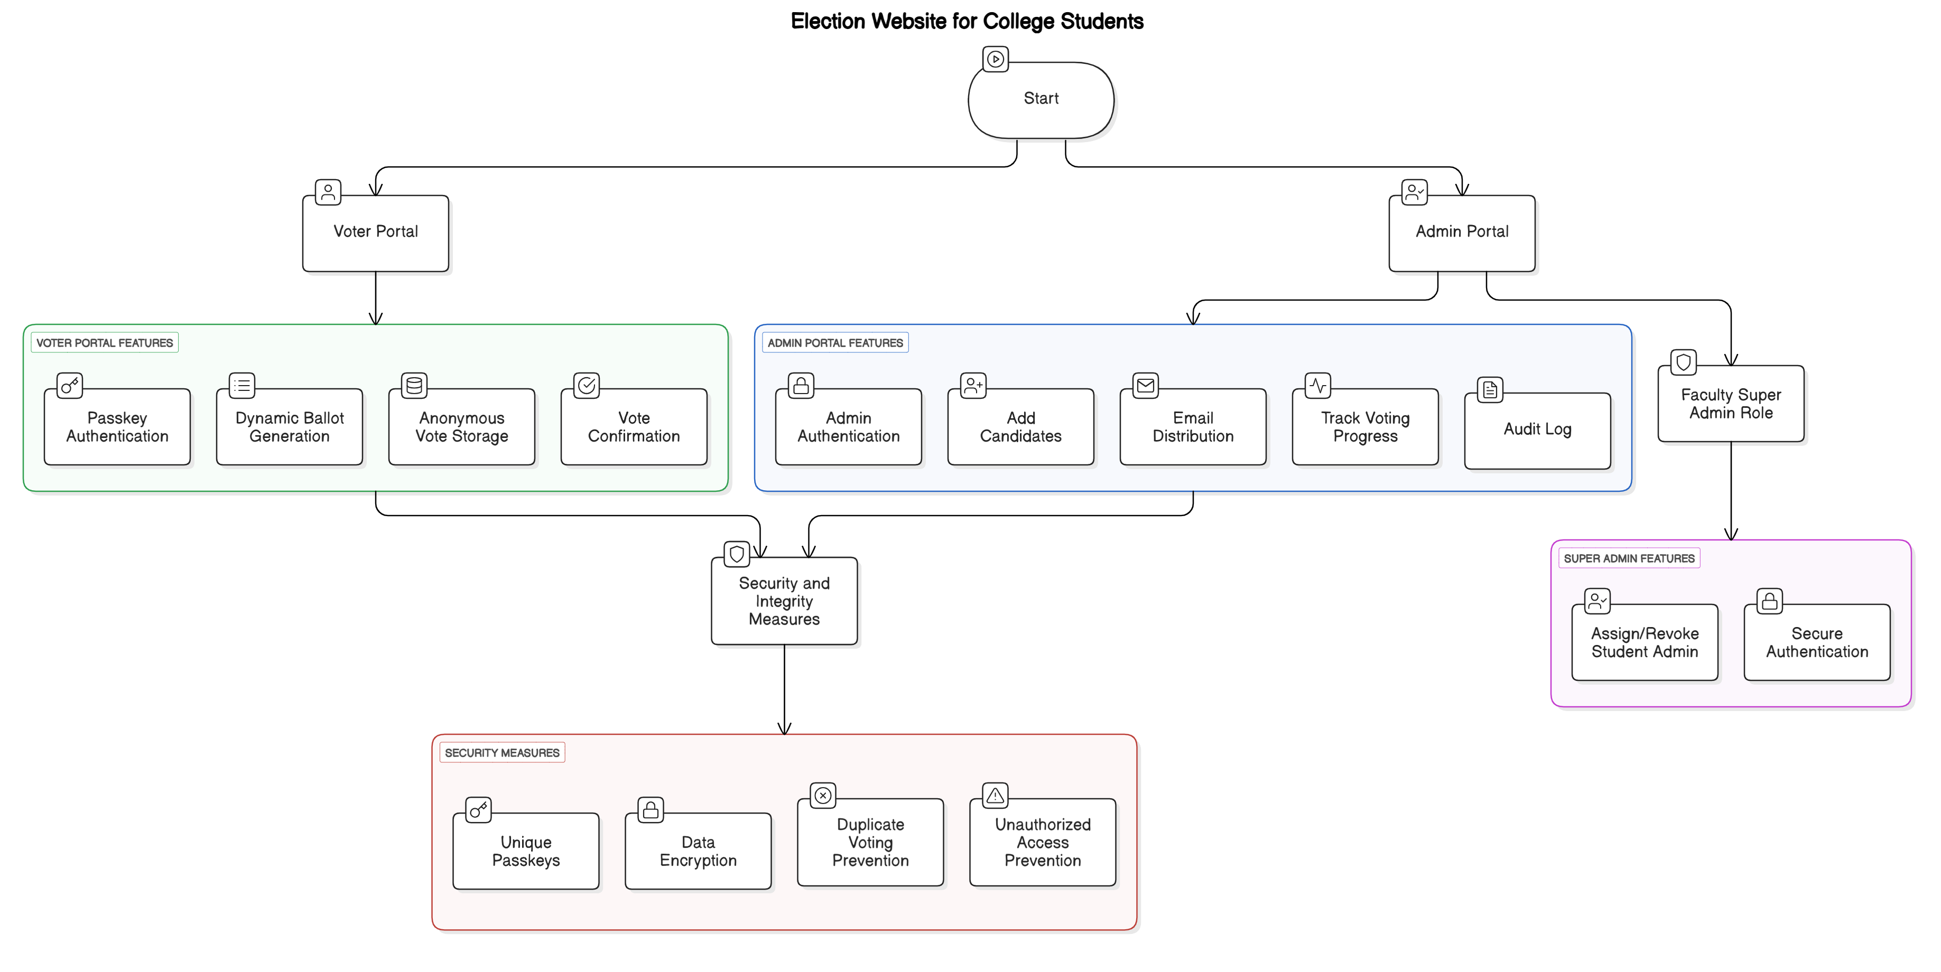
Flow Diagram

Slide 7
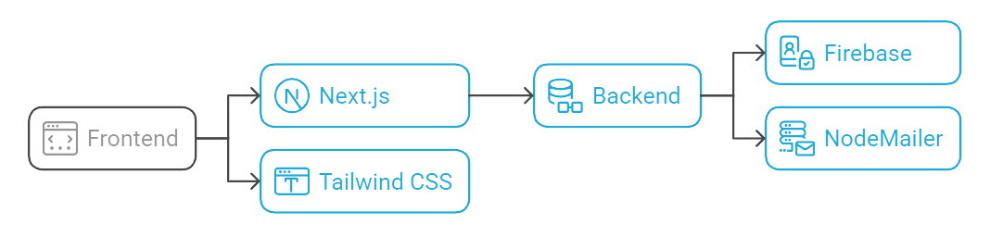
Tech Stack
Frontend:
Next.js (for server-side rendering and routing).
Tailwind CSS (for responsive and modern UI).
Backend:
Firebase (for real-time database and authentication).
Email Service:
Nodemailer (for sending OTPs and passkeys).
Programming Language:
JavaScript (for full-stack development).

Slide 8
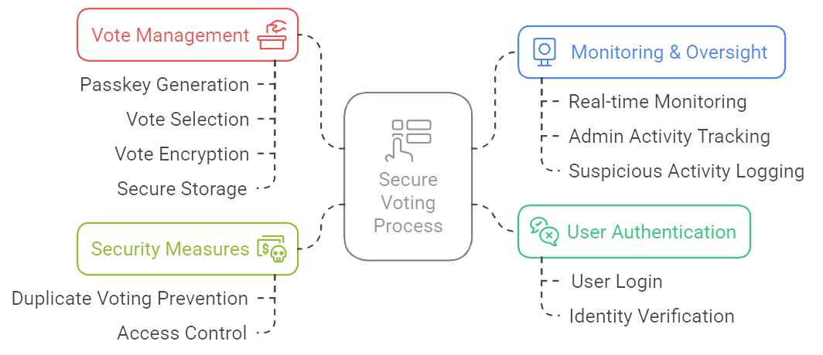
Security Measures
Unique, non-reusable passkeys for each voter.
Data encryption for vote storage and transmission.
Prevention of duplicate voting and unauthorized access.
Audit logs for admin actions.
Real-time monitoring of voting progress.

Slide 9
Challenges and Solutions
Challenge 1: Ensuring voter eligibility.
Solution: Dynamic ballot generation based on filters.
Challenge 2: Preventing duplicate voting.
Solution: Unique passkeys and OTP verification.
Challenge 3: Real-time vote tracking.
Solution: Firebase real-time database.
Challenge 4: Scalability.
Solution: Modular and efficient code structure.

Slide 10
Future Scope & Conclusion
Future Scope:
Mobile App: Cross-platform app for on-the-go voting.
Face Recognition: OpenCV for secure voter authentication.
Advanced Analytics: Insights into election trends and voter behaviour.
Blockchain: Enhanced transparency and security.
Conclusion:
CampusElect ensures secure, transparent, and efficient college elections.
Addresses key challenges like voter eligibility and duplicate voting.
Scalable and user-friendly platform for fair elections.

Slide 11
Thank You

